Slide 1

Attribute Inference Attacks for Federated Regression Tasks
Francesco Diana, COATI team, francesco.diana@inria.fr
27/06/2025

Slide 2



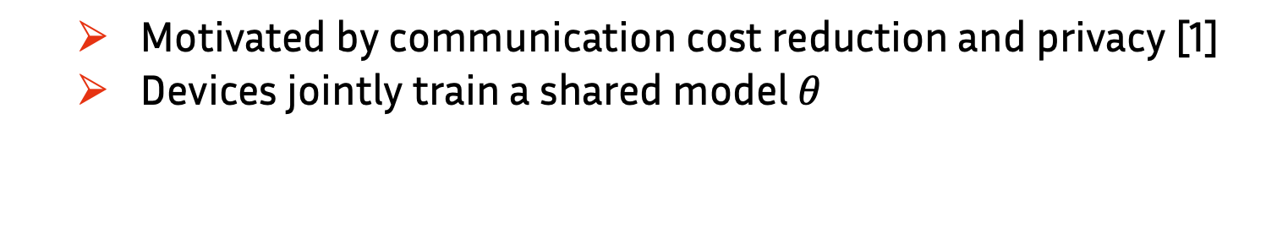
Federated Learning (FL)
  Motivated by communication cost reduction and privacy [1]
  Devices jointly train a shared model $θ$
[1] McMahan, B.; Moore, E.; Ramage, D.; Hampson, S.; and Agüera y Arcas, B. 2017. Communication-efficient learning of deep networks from decentralized data. In Artificial Intelligence and Statistics,1273–1282. PMLR
Notes:
First, let’s introduce Federated learning, which is a distributed learning paradigm where a set of clients collaborate with a central server to train a shared model. This work was initially motivated by communication cost reduction, asa we don’t need to transmit all the data, but only updates.
The goal is to minimize a global loss that is obtained as weighted sum of the loss of each client on her local dataset Sc.

Slide 3
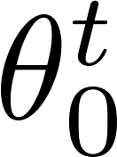
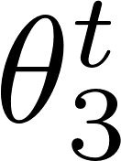
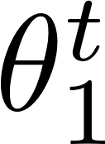
Federated Learning (FL)
  Motivated by communication cost reduction and privacy [1]
  Devices jointly train a shared model $θ$
[1] McMahan, B.; Moore, E.; Ramage, D.; Hampson, S.; and Agüera y Arcas, B. 2017. Communication-efficient learning of deep networks from decentralized data. In Artificial Intelligence and Statistics,1273–1282. PMLR
Notes:
Federated learning is a distributed learning paradigm where a set of clients collaborate with a central server to train a shared model. This work was initially motivated by communication cost reduction, asa we don’t need to transmit all the data, but only updates.
The goal is to minimize a global loss that is obtained as weighted sum of the loss of each client on her local dataset Sc.

Slide 4
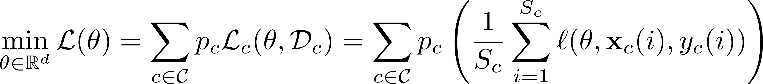
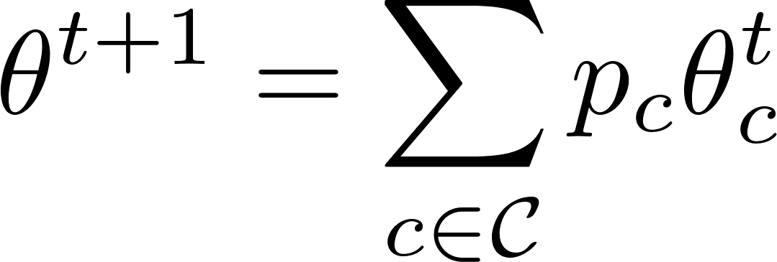
Federated Learning (FL)
  Motivated by communication cost reduction and privacy [1]
  Devices jointly train a shared model $θ$
[1] McMahan, B.; Moore, E.; Ramage, D.; Hampson, S.; and Agüera y Arcas, B. 2017. Communication-efficient learning of deep networks from decentralized data. In Artificial Intelligence and Statistics,1273–1282. PMLR
Notes:
Federated learning is a distributed learning paradigm where a set of clients collaborate with a central server to train a shared model. This work was initially motivated by communication cost reduction, asa we don’t need to transmit all the data, but only updates.
The goal is to minimize a global loss that is obtained as weighted sum of the loss of each client on her local dataset Sc.

Slide 5
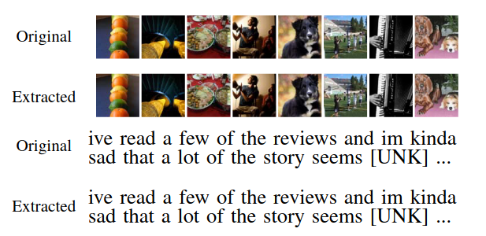
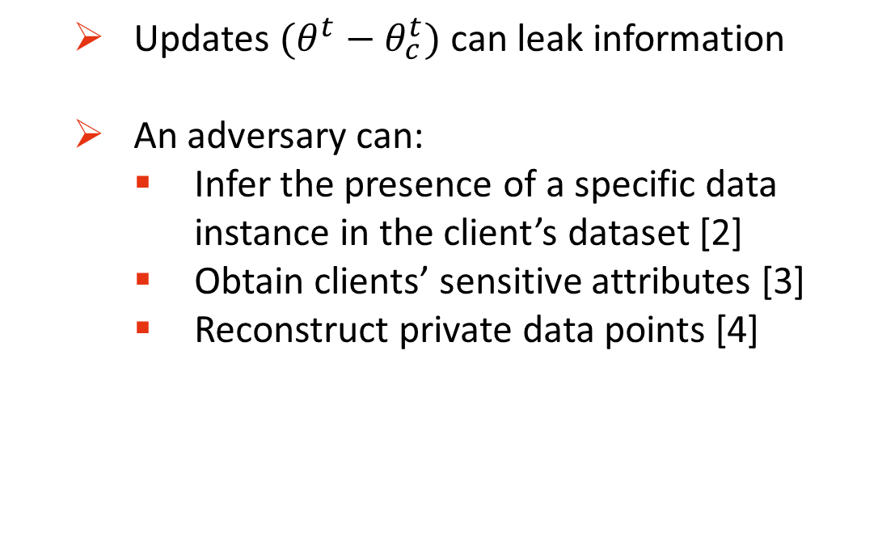
Is FL really private?
  Updates $(θ^{t}−θ_{c}^{t})$can leak information
  An adversary can:
    Infer the presence of a specific data instance in the client’s dataset [2]
    Obtain clients’ sensitive attributes [3]
    Reconstruct private data points [4]
Figure: sample reconstruction attack from [4]
[2] Nasr, M.; Shokri, R.; and Houmansadr, A. 2019. Comprehensive privacy analysis of deep learning: Passive and active white-box inference attacks against centralized and federated learning. In 2019 IEEE Symposium on Security and Privacy (SP), 739–753. IEEE
[3] Chen, C.; Lyu, L.; Yu, H.; and Chen, G. 2022. Practical Attribute Reconstruction Attack Against Federated Learning. IEEE Trans-actions on Big Data, 1–1
[4] Boenisch, F.; Dziedzic, A.; Schuster, R.; Shamsabadi, A. S.; Shumailov, I.; and Papernot, N. 2023. When the Curious Abandon Honesty: Federated Learning Is Not Private. In2023 IEEE 8th European Symposium on Security and Privacy (EuroS&P), 175–199.
Notes:
For example, imagine to train a regression model for a drug dosage prediction task. Sensitive attributes that might not be disclosed can be binary attributes indicating a particular medical condition of a patient or some specific gene.

Slide 6
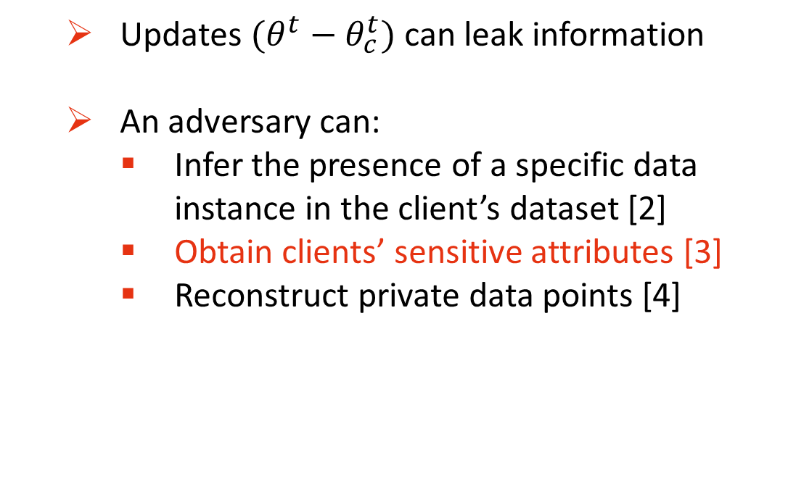
Is FL really private?
  Updates $(θ^{t}−θ_{c}^{t})$can leak information
  An adversary can:
    Infer the presence of a specific data instance in the client’s dataset [2]
    Obtain clients’ sensitive attributes [3]
    Reconstruct private data points [4]
Figure: sample reconstruction attack from [4]
[2] Nasr, M.; Shokri, R.; and Houmansadr, A. 2019. Comprehensive privacy analysis of deep learning: Passive and active white-box inference attacks against centralized and federated learning. In 2019 IEEE Symposium on Security and Privacy (SP), 739–753. IEEE
[3] Chen, C.; Lyu, L.; Yu, H.; and Chen, G. 2022. Practical Attribute Reconstruction Attack Against Federated Learning. IEEE Trans-actions on Big Data, 1–1
[4] Boenisch, F.; Dziedzic, A.; Schuster, R.; Shamsabadi, A. S.; Shumailov, I.; and Papernot, N. 2023. When the Curious Abandon Honesty: Federated Learning Is Not Private. In2023 IEEE 8th European Symposium on Security and Privacy (EuroS&P), 175–199.
Notes:
For example, imagine to train a regression model for a drug dosage prediction task. Sensitive attributes that might not be disclosed can be binary attributes indicating a particular medical condition of a patient or some specific gene.

Slide 7
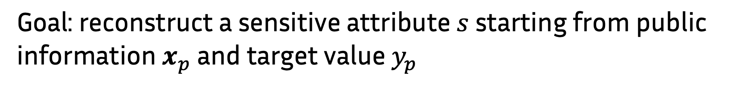
Attribute Inference Attack
Goal: reconstruct a sensitive attribute $s$ starting from public information $x_{p}$ and target value $y_{p}$

Slide 8
Attribute Inference Attack
Goal: reconstruct a sensitive attribute $s$starting from public information $x_{p}$ and target value${ y}_{p}$
  Two existing approaches:
    Gradient based [4]
    Model based [5]
[5] Fredrikson, M.; Lantz, E.; Jha, S.; Lin, S.; Page, D.; and Ristenpart, T. 2014. Privacy in pharmacogenetics: An end-to-end case study of personalized warfarin dosing. In 23rd{USENIX}Security Symposium ({USENIX}Security 14), 17–32.

Slide 9


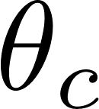
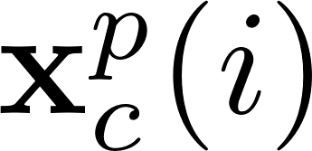
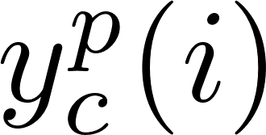
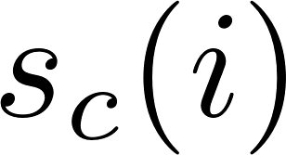
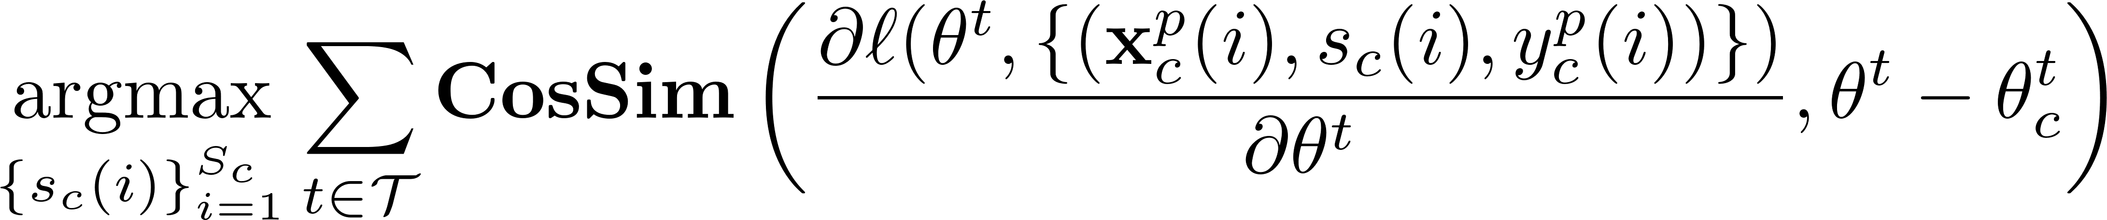
Gradient-based AIA
    Setting:
      Clients , global model , client model
      Adversary has access to and
      is binary
Notes:
The idea is to identify the sensitive attribute values that maximize the cosine similarity between virtual gradients and client’s model updates, also called pseudogradients.

Slide 10
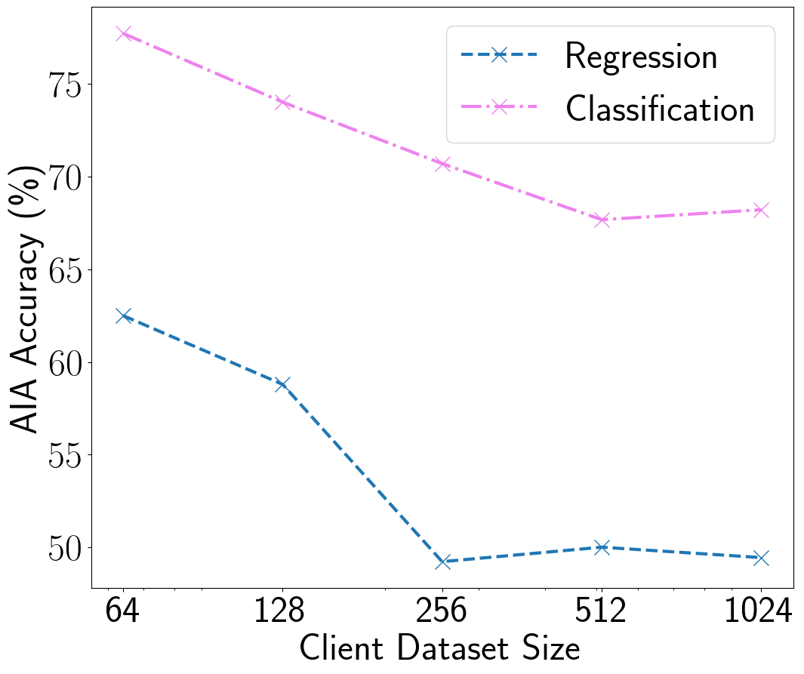

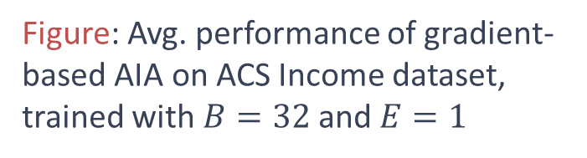
Gradient-based AIA
    Limitations:
      Evaluated only on classification tasks
      Attack accuracy drops with large local dataset size
Figure: Avg. performance of gradient-based AIA on ACS Income dataset, trained with $B=32$and $E=1$
Notes:
Now this attack was evaluated only on classification tasks. However, on regression tasks, the attack accuracy drops to random guess with a client dataset size of 256.

Slide 11
Model-based AIA
  Proposed in centralized setting
Notes:
Another approach for AIA is the model based attack, proposed in the centralized setting. Here the idea is to select the sensitive attribute value that minimize the loss. However the accuracy of the attack is highly correlated to the ability of the model to overfit the training data. In FL, due to the aggregation step, overfitting is limited, as we can see from the figure on the right. Here, the orange line indicates the performance of the attack of the global model obtained after a FL training procedure. Even if it always performs better than the gradient based attack, it is still not close to the optimal performance in green, which are the ones that we could potentially get by training each client on its local dataset.

Slide 12
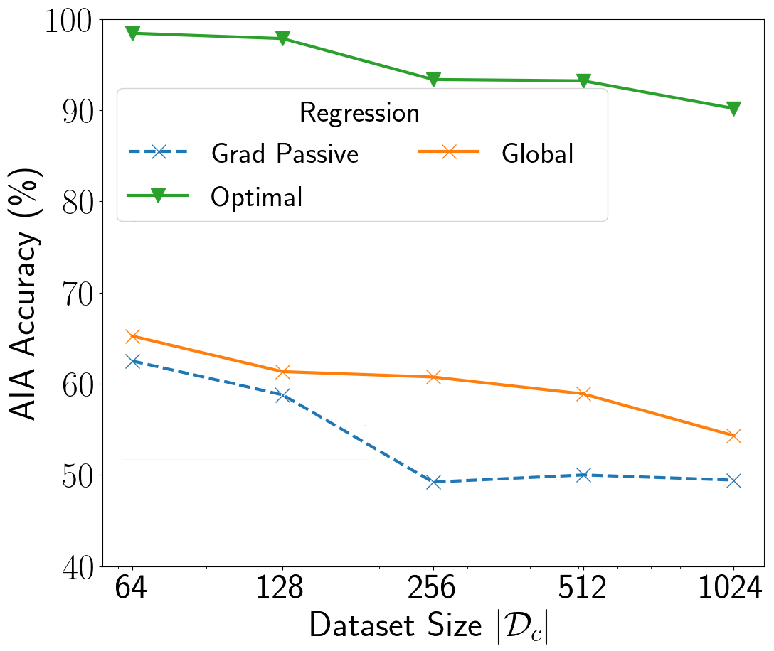
Model-based AIA
  Proposed in centralized setting
  The attack requires the model to be overfitted
Figure: model based vs. gradient based AIA in FL
Notes:
Another approach for AIA is the model based attack, proposed in the centralized setting. Here the idea is to select the sensitive attribute value that minimize the loss. However the accuracy of model inversion attacks is highly correlated to the ability of the model to overfit the training data. In FL, due to the aggregation step, overfitting is limited, as we can see from the figure on the right. Here, the orange line indicates the performance of the attack of the global model obtained after a FL training procedure. Even if it always performs better than the gradient based attack, it is still not close to the optimal performance in green, which are the ones that we could potentially get by training each client on its local dataset.

Slide 13
Our work
  Adapt model-based AIA to federated regression tasks
Notes:
The previous slides motivated our work to adapt the model-based AIA to federated regression tasks. Our attack can be separated in a two step procedure: first, we show how to reconstruct the optimal local model (optimal in sense of minimization error), and then we apply the model based attack to infer the sensitive attribute values.

Slide 14
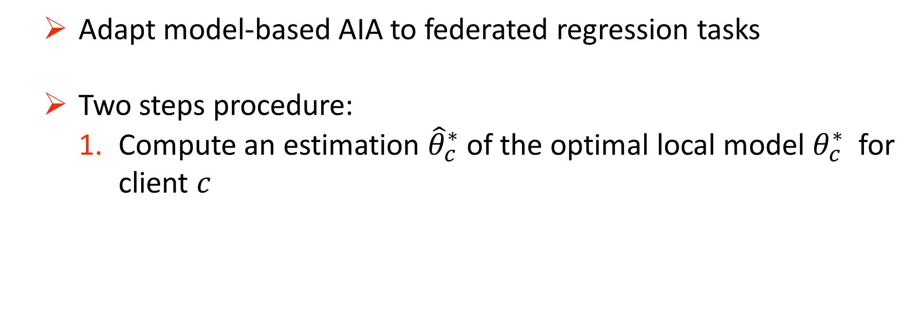
Our work
  Adapt model-based AIA to federated regression tasks
  Two steps procedure:
    Compute an estimation ${\hat{θ}}_{c}^{∗}$ of the optimal local model $θ_{c}^{∗}$ for client $c$
Notes:
The previous slides motivated our work to adapt the model-based AIA to federated regression tasks. Our attack can be separated in a two step procedure: first, we show how to reconstruct the optimal local model (optimal in sense of minimization error), and then we apply the model based attack to infer the sensitive attribute values.

Slide 15
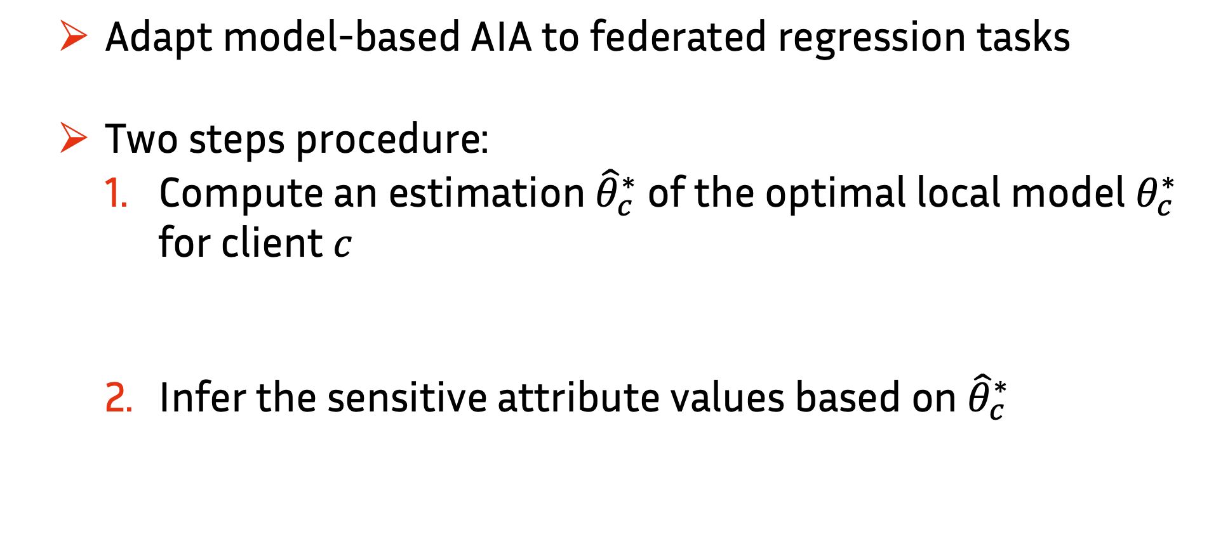
Our work
  Adapt model-based AIA to federated regression tasks
  Two steps procedure:
    Compute an estimation ${\hat{θ}}_{c}^{∗}$ of the optimal local model $θ_{c}^{∗}$ for client $c$
    Infer the sensitive attribute values based on ${\hat{θ}}_{c}^{∗}$
Notes:
The previous slides motivated our work to adapt the model-based AIA to federated regression tasks. Our attack can be separated in a two step procedure: first, we show how to reconstruct the optimal local model (optimal in sense of minimization error), and then we apply the model based attack to infer the sensitive attribute values.

Slide 16
Contributions
  A method to reconstruct the optimal local model in the honest-but-curious setting for least squares regression problems, with analytical guarantees

Slide 17
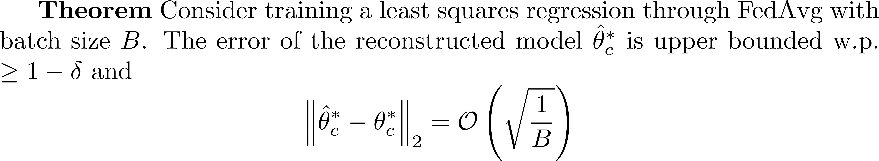
Optimal local model reconstruction
Notes:
The following theorem indeed shows that the error of the reconstructed model will scale with the batch size used for training.

Slide 18
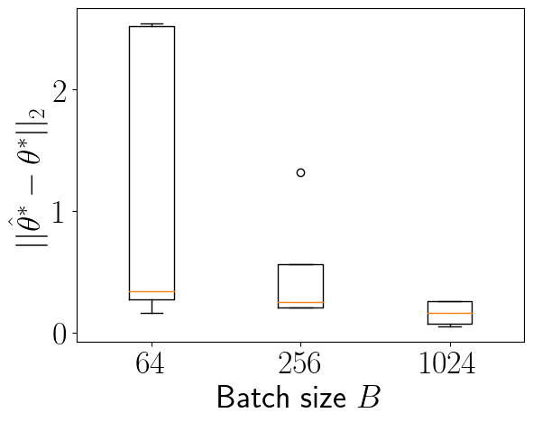
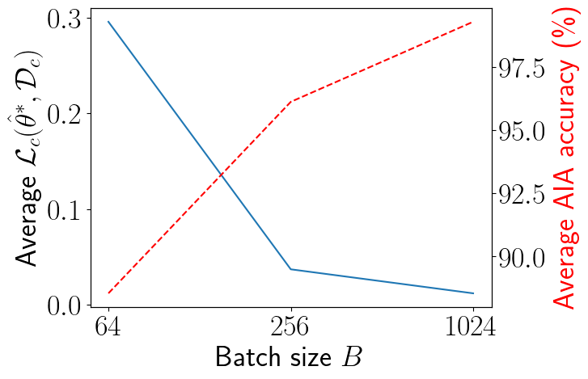
Optimal local model reconstruction
Notes:
Here, experiments on a toy dataset show exactly this: by considering: on the left we see how the reconstruction error goes to 0 when we increase the batch size up to the local dataset size. The right plot instead shows the correlation between the loss of the reconstructed model on the client dataset and the accuracy of the attack, empahasizing the connection between attack accuracy and overfitting.

Slide 19
Contributions
  A method to reconstruct the optimal local model in the honest-but-curious setting for least squares regression problems, with analytical guarantees
  A general method for approximating optimal local models in the active setting (the attacker can interfere with the training process)
Notes:
In this case we do not make assumption on the type of the model, and we can consider a generale neural network model.

Slide 20

Active attack
  Server interferes with the training process
  Idea: isolate client $c$ to simulate local training
Notes:
By doing so, the server could potentially send back the same model that he receives from each client, that would allow to imitate a local training of each client. However, this operation would be easy to detect, and the process would require many steps to converge to local training optima.

Slide 21
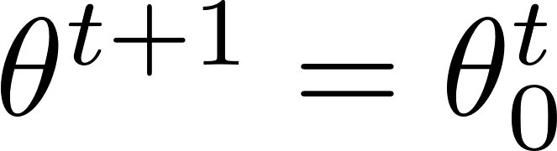
Active attack
  Server interferes with the training process
  Idea: isolate client $c$ to simulate local training
Notes:
By doing so, the server could potentially send back the same model that he receives from each client, that would allow to imitate a local training of each client. However, this operation would be easy to detect, and the process would require many steps to converge to local training optima.

Slide 22
Active attack
  Server interferes with the training process
  Idea: isolate client $c$ to simulate local training
Notes:
By doing so, the server could potentially send back the same model that he receives from each client, that would allow to imitate a local training of each client. However, this operation would be easy to detect, and the process would require many steps to converge to local training optima.

Slide 23
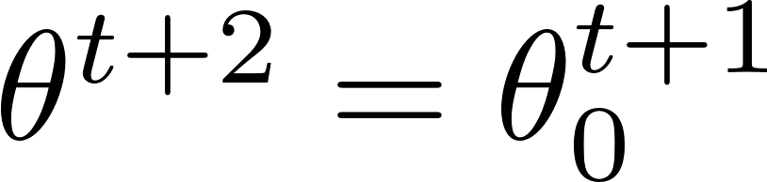
Active attack
  Server interferes with the training process
  Idea: isolate client $c$ to simulate local training
Notes:
By doing so, the server could potentially send back the same model that he receives from each client, that would allow to imitate a local training of each client. However, this operation would be easy to detect, and the process would require many steps to converge to local training optima.

Slide 24
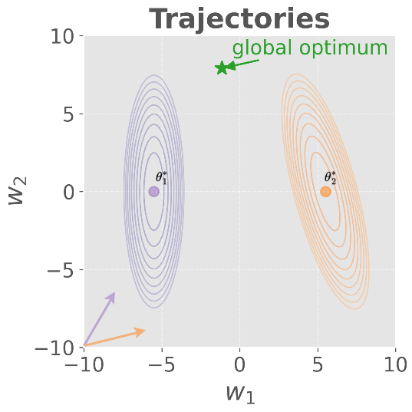
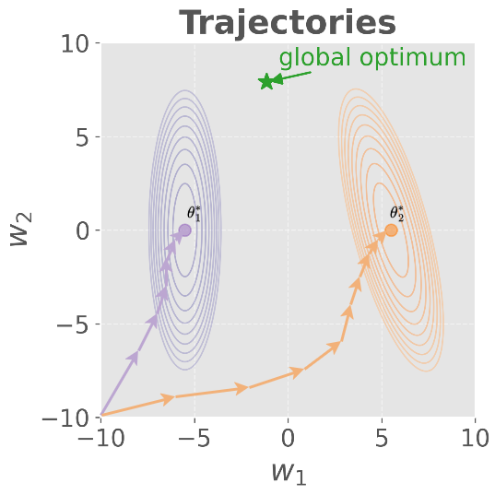
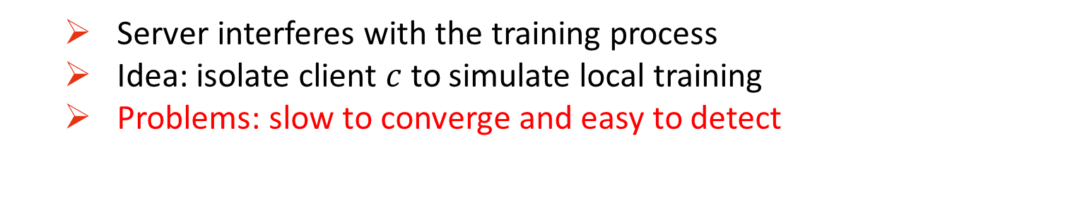
Active attack
  Server interferes with the training process
  Idea: isolate client $c$ to simulate local training
  Problems: slow to converge and easy to detect
Notes:
By doing so, the server could potentially send back the same model that he receives from each client, that would allow to imitate a local training of each client. However, this operation would be easy to detect, and the process would require many steps to converge to local training optima.

Slide 25
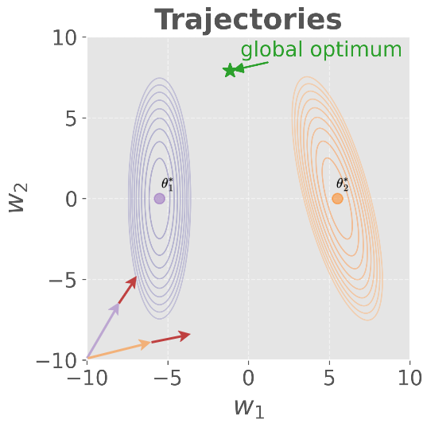
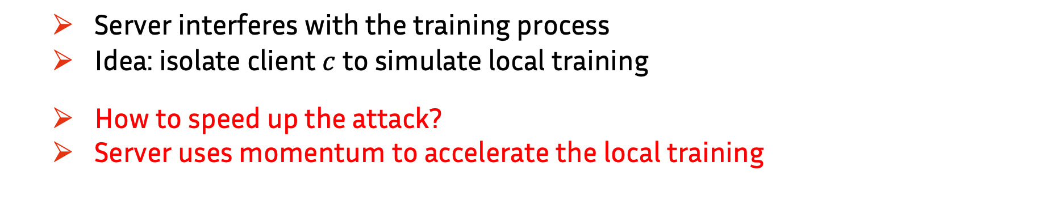
Active attack
  Server interferes with the training process
  Idea: isolate client $c$ to simulate local training
  How to speed up the attack?
  Server uses momentum to accelerate the local training
Notes:
To speed up the attack, the server uses the pseudo-gradient to compute moment vectors, and then updates the model that will send back to each client. By doing so, it accelerates the minimization of the local training error.

Slide 26
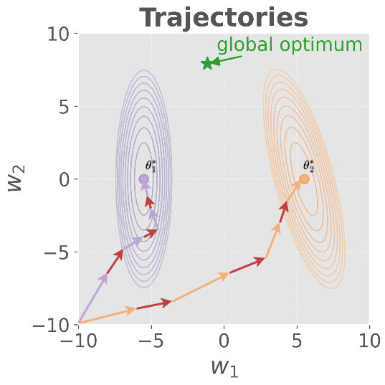
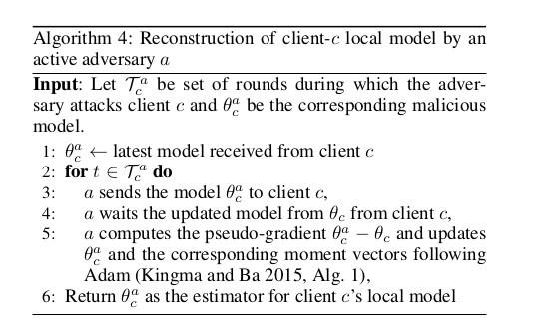
Active attack
  Server interferes with the training process
  Idea: isolate client $c$ to simulate local training
  How to speed up the attack?
  Server uses momentum to accelerate the local training
Notes:
To speed up the attack, the server uses the pseudo-gradient to compute moment vectors, and then updates the model that will send back to each client. By doing so, it accelerates the minimization of the local training error.

Slide 27
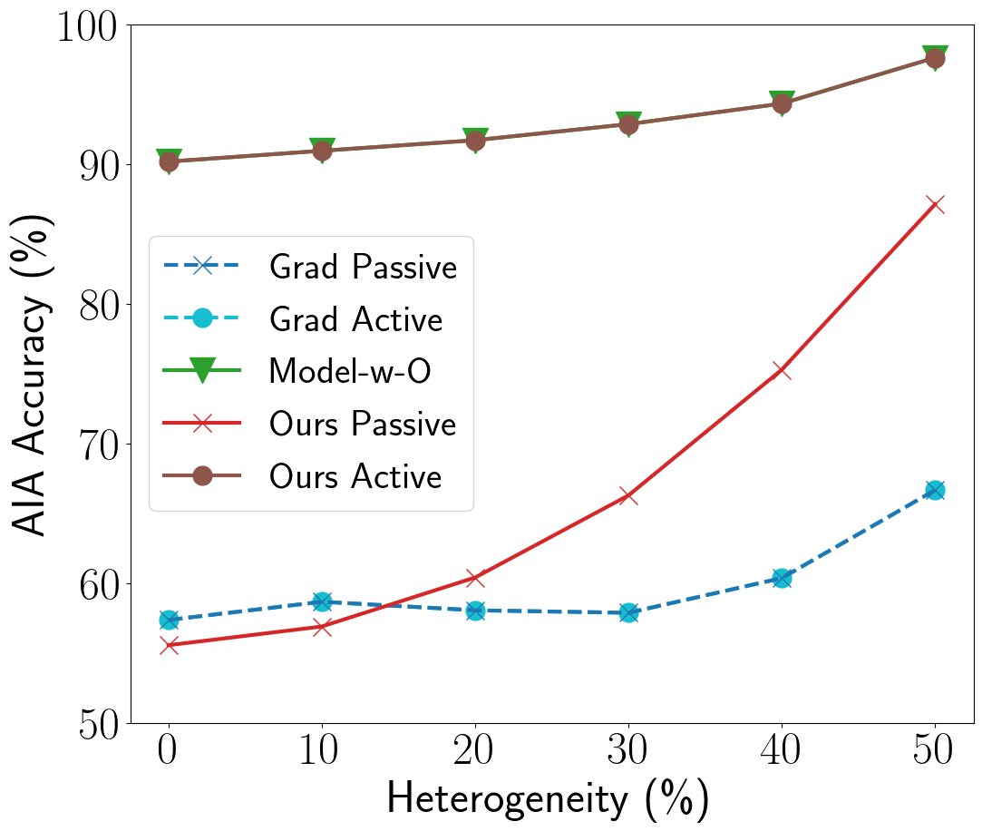
Results
  ACS Income dataset
  10 clients
  One-hidden-layer NN (128 neurons)
  100 training rounds
  50 active rounds
  Sensitive attribute: gender
Figure: Clients’ heterogeneity dataset on Income
Notes:
In the experiments, we use the ACS Income dataset, which is a regression dataset, whose task is to predict the income of the US population, given census information. Here, we consider 10 clients, each one training a neural network with one hidden layer for 100 rounds. After these rounds, we run 50 additional active attack rounds, where the server performs the attack. In the plot on the right, we can observe the effect of the client’s heterogeneity. Here, we see that as a general effect, more heterogeneous settings tend to leak more information. Also, we can notice how our active attack matches the empirical optimal performance, denoted as model-with oracle, and also that our passive attack (obtained after standard training with
a honest but curious attacker who uses the last returned model by the client), can perform better than the gradient based attacks, in both passive and active scenario, where in the active case the server returns the same model to the client.

Slide 28
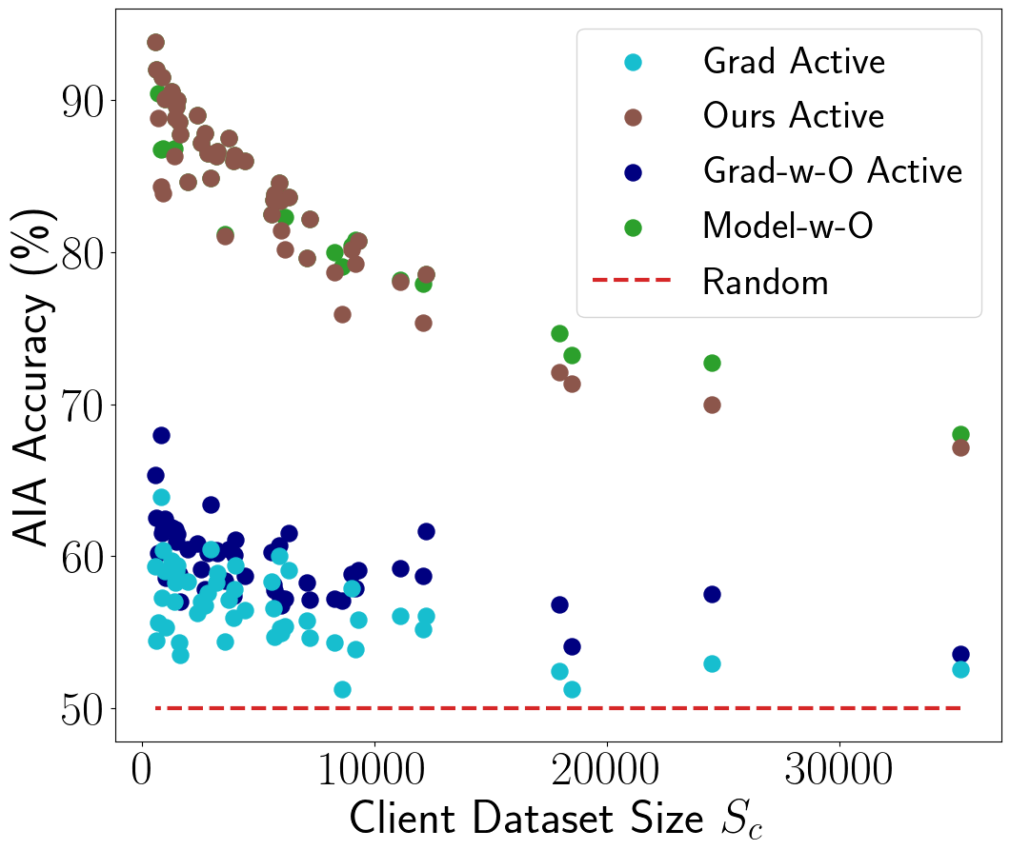
Results
  ACS Income dataset
  51 clients
  One-hidden-layer NN (128 neurons)
  100 training rounds
  50 active rounds
  Sensitive attribute: gender
Figure: Local dataset size effect on Income
Notes:
Here, we consider instead a different scenario, with 51 clients, each one with a different number of datapoints. What we can notice is that the larger the client local dataset, the worse are the attack performance. This effect is expected as it is more difficult for the model to overfit large datasets. However, our attack consistently outperforms the gradient based attack by more than 15 percentage points.

Slide 29
Conclusions
  First AIA on federated regression tasks
  Analytical guarantees on federated least squares regression
  Active strategy for neural networks

Slide 30

Thank you!
F. Diana, O. Marfoq, C. Xu, G. Neglia, F. Giroire, E. Thomas, Attribute Inference Attacks for Federated Regression Tasks, AAAI, 2025

Slide 31
Bibliography
[1] McMahan, B.; Moore, E.; Ramage, D.; Hampson, S.; and Agüera y Arcas, B. 2017. Communication-efficient learning of deep networks from decentralized data. In Artificial Intelligence and Statistics,1273–1282. PMLR
[2] Nasr, M.; Shokri, R.; and Houmansadr, A. 2019. Comprehensive privacy analysis of deep learning: Passive and active white-box inference attacks against centralized and federated learning. In 2019 IEEE Symposium on Security and Privacy (SP), 739–753. IEEE
[3] Chen, C.; Lyu, L.; Yu, H.; and Chen, G. 2022. Practical Attribute Reconstruction Attack Against Federated Learning. IEEE Trans-actions on Big Data, 1–1
[4] Boenisch, F.; Dziedzic, A.; Schuster, R.; Shamsabadi, A. S.; Shumailov, I.; and Papernot, N. 2023. When the Curious Abandon Honesty: Federated Learning Is Not Private. In2023 IEEE 8th European Symposium on Security and Privacy (EuroS&P), 175–199.
[5] Fredrikson, M.; Lantz, E.; Jha, S.; Lin, S.; Page, D.; and Ristenpart, T. 2014. Privacy in pharmacogenetics: An end-to-end case study of personalized warfarin dosing. In 23rd{USENIX}Security Symposium ({USENIX}Security 14), 17–32.

Slide 32
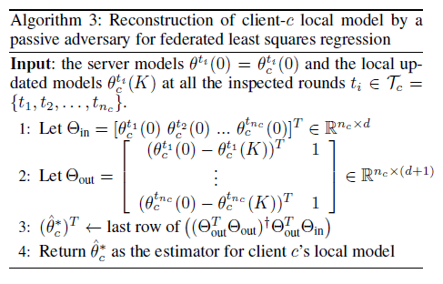
Reconstruction Algorithm

Slide 33
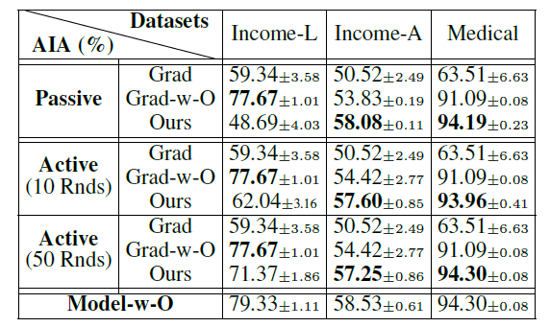
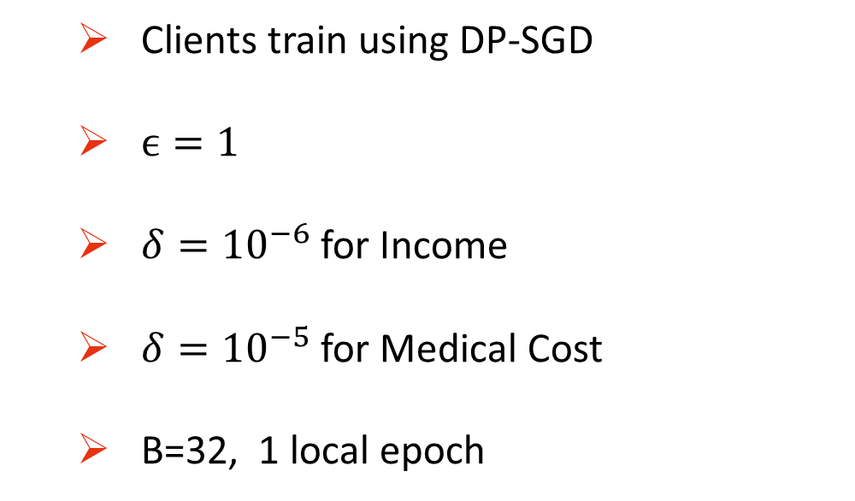
DP results
  Clients train using DP-SGD
  $ϵ=1$
  $δ={10}^{−6}$ for Income
  $δ={10}^{−5}$for Medical Cost
  B=32, 1 local epoch

